Slide 1
The Battle of NEIGHBORHOOD
Coursera Capstone Project

Slide 2
Introduction/Business Problem
Moving decision from West of Toronto to Downtown Toronto
Areas that I'm interested needs to meet the following criteria:
A neighborhood with an average to above average total population
Above average populations of 25–40-year-old male and female professionals
A high concentration of the population having secondary education
Average to above average median net household incomes

Slide 3
Data
City of Toronto Neighborhood
City of Toronto Neighborhood Shapes
Wikipedia for Toronto Neighborhood Borough Designation
Foursquare API

Slide 4
METHODOLOGY
Pandas – Library for Data Analysis
Numpy – Library to handle data/venues
JSON – Library to handle JSON FILES
Geopy – To retrieve Location Data
Requests – Library to handle http requests
Matplotlib – Python Plotting Modele
Sklearn – Python machine learning Library
Folium – Map rendering Library
Beautiful Soup - Python package for parsing HTML and XML documents
Foursquare API

Slide 5
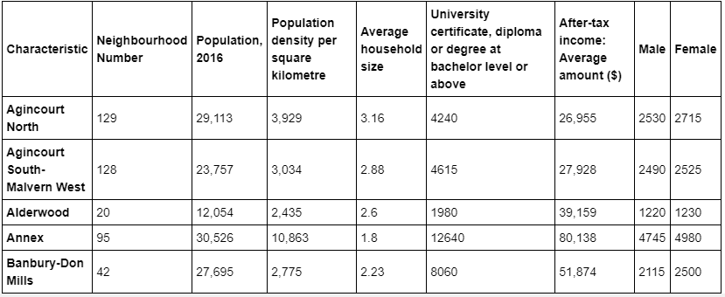
analysis
2016 Census Data - Data was pulled into from the City of Toronto Neighborhoods Profile Census CSV File to create a dataframe.

Slide 6
analysis
Wikipedia data - neighborhoods with boroughs - Wikipedia page for Toronto Neighborhood Borough Designations is scraped using Beautiful Soup

Slide 7
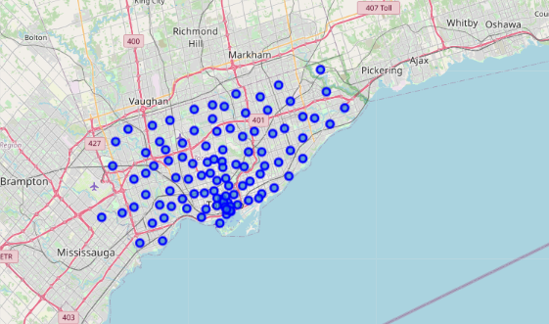
analysis
Map of Toronto Neighborhoods

Slide 8
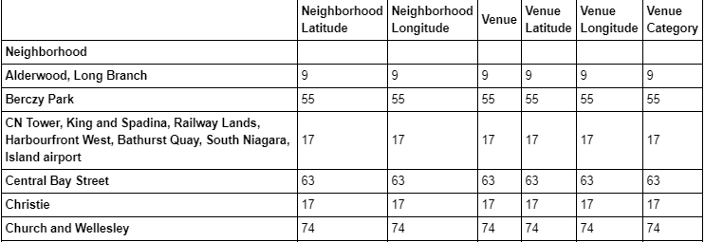
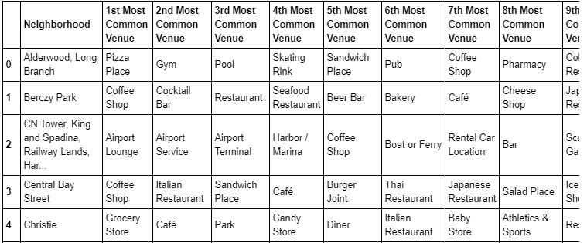
analysis
Using Foursquare API to analyze Neighborhoods in Downtown Toronto and Etobicoke

Slide 9
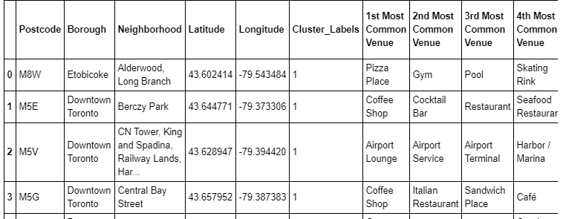
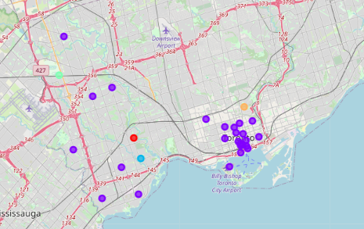
Results
Clustering the Neighborhoods

Slide 10
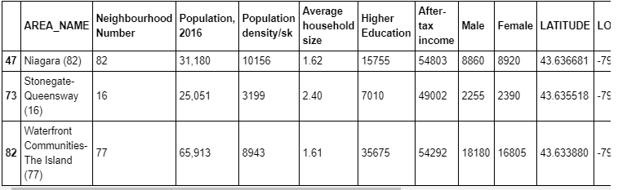
Results
Census Data
Even though most of the neighborhoods in Etobicoke are in the same cluster as of neighborhoods in Downtown Toronto, the venues within the two Borough are different. However, they do have same level of similarities as well
Most common venues in Downtown Toronto are cafes and restaurants and Parks. Parks and restaurants are also a common venue in Etobicoke area.
Although restaurant is a common venue in both Borough, the cuisines might be very different, and further research need to be done on that. On the other hand, Etobicoke area has some hardware stores that Downtown doesn't have

Slide 11
Conclusion
To sum up, the analysis above would support my moving decision from Etobicoke to Downtown Toronto.
From the population census perspective, Downtown Toronto has far more people with higher education, and more young people from age 25 to 40. The household income in Downtown is also a lot higher than in Etobicoke. However, the overall population in Downtown is higher than Etobicoke, so I may feel crowd if moving to Downtown.
From the venue’s perspective, Downtown has more cafes and restaurants than the area I live.
Overall, Downtown is more suitable for young professionals or people looking for more social life and likes the busy part of the city.

